Slide 1
PERSONAL VOICE ASSISTANT IN PYTHON
Submitted By:

Slide 2
Contents
Introduction
Dataflow diagrams
Technologies
Use case diagrams
screenshots
Requirements
Conclusion

Slide 3
Introduction
Personal Voice Assistant Using Python
Welcome to our presentation on building a voice-activated virtual assistant using Python. In today's world, technology has advanced to the point where we can interact with computers using our voices. This project aims to demonstrate how we can create a virtual assistant that listens to our voice commands and responds accordingly.

Slide 4
Dataflow Diagrams
DFD - 0
Personal voice assistant
Speech to Text
User
Voice
Action
Computer
Response
Voice output
Text to speech

Slide 5
Technologies Used By Python Libraries
Speech Recognition: We used a special library that can understand what people say. It listens to what you say and understands it so your program can respond.
Pyttsx3: Helps convert text into spoken words, also known as text-to-speech (TTS) synthesis. It turns written words into spoken words so your program can talk to you.
Pywhatkit: Provides easy access to various functionalities like playing songs on YouTube, sending WhatsApp messages, and more. It lets your Python program do cool things like playing music or sending messages on your behalf.
Webbrowser: Allows Python programs to open web pages in a web browser. It helps your Python program to open websites, just like you do when you click on a link in a web browser.

Slide 6
Use case diagrams
Search
Open Chatgpt
Open Whatsapp
Open new tab
Open and close Applications
Open Youtube
Web browser
Take
screen shots
Input voice
Wikipedia
Read search
User
Play /Stop
Music
Ask Time

Slide 7
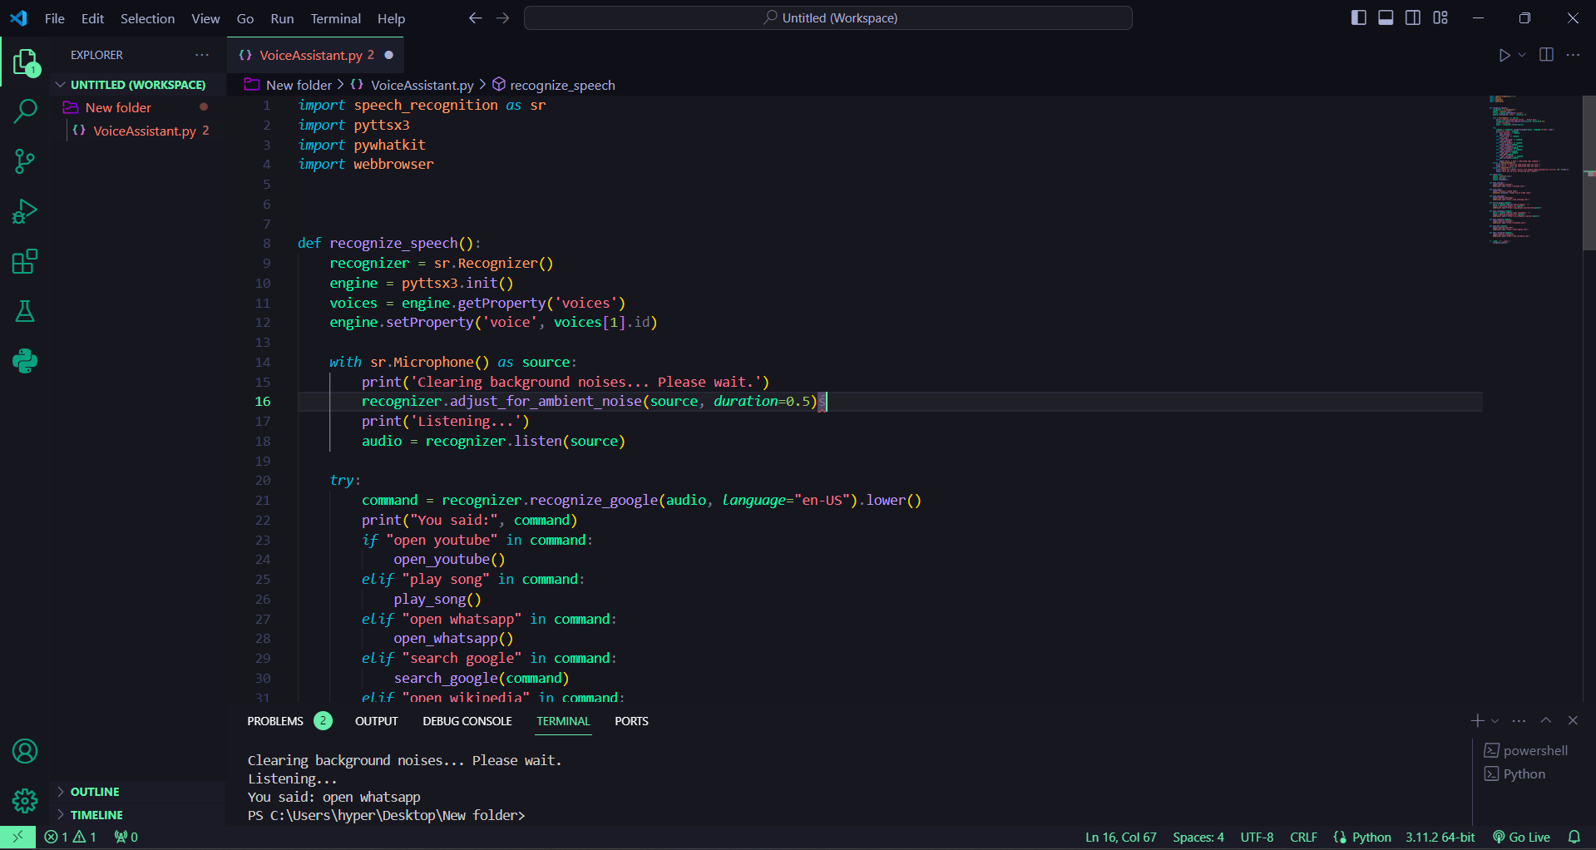
Screenshots

Slide 8
Requirements
Software requirements
VS Code Editor
Python 3.11.2 and its Sub modules
Hardware requirements
Intel core i3
8gb RAM
30 Gb Hard drive space

Slide 9
Conclusion
In summary, Python libraries like speech recognition, pyttsx3, pywhatkit, and web browser make it simple for developers to create cool programs. With them, you can make your computer understand your voice, talk back to you, play songs, send messages, and open websites, all with just a few lines of code.
These libraries open up a world of possibilities for making fun and useful applications. So, let's keep coding and exploring the exciting world of Python together!

Slide 10
THANK YOU

